Slide 1
HTML for beginners

Slide 2
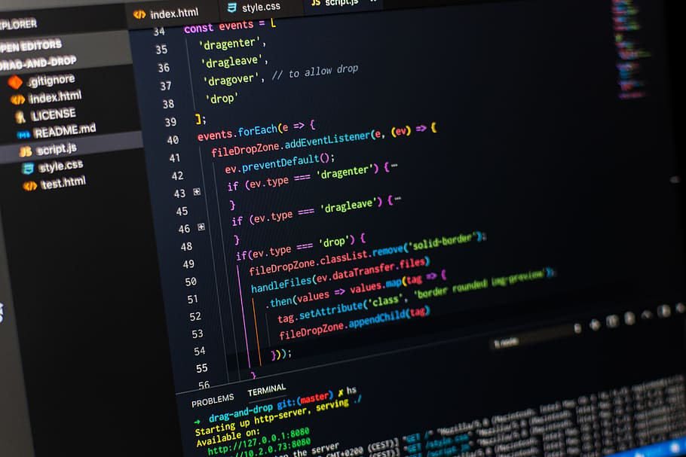

Slide 3


Slide 4
Introduction of html
Html is the scripting language for creating web pages.
It is developed by Tim Berners-Lee.
Html stands for Hyper Text Markup Language.

Slide 5
What is tag?
HTML tag are the hidden keywords with in a webpage that define how your web browser must format and display the content .
Like :-
<HTML></HTML>
<HEAD></HEAD>

Slide 6
Basic software need for html
Any text editor :- like Notpad,Notpad++,Visual Studio code.
Any web browser :- like Internet explorer, Mozilla Firefox, google chrome etc.…

Slide 7
Basic structure of HTML
<HTML>
<HEAD>
<TITLE>Title of the document</TITLE>
</HEAD>
<BODY>
…………………………………….
…………………………………….
</BODY>
</HTML>

